Slide 1
Treatment of Pelvic floor Dysfunction
Dr. Sanskruti Tahakik
Dept. Of Community Physiotherapy
Mgm Institute Of Physiotherapy
Chh. Sambhajinagar

Slide 2
Contents
Introduction
Anatomy
Role of the physical therapist in pelvic floor dysfunction
Techniques of pelvic floor muscle re-education
Recent advances

Slide 3
Objective
Overview anatomy of pelvic floor
Dysfunction and treatment
Recent advances

Slide 4
Introduction
The pelvic floor consists of layers of muscle that provide a‘ hammock’ or ‘sling’ from the pubic bone at the front to the coccyx at the back.
Its function is to support the pelvic organs—the bladder and rectum, helping to keep these structures in the correct position.

Slide 5
This network of muscles (e.g., levator ani muscles), fascia (e.g., urogenital diaphragm, endopelvic fascia including the pubocervical and rectovaginal),
nerves, and ligaments (e.g., uterosacral and cardinal ligaments) provides support on which the pelvic organs rest.

Slide 6
Levator ani muscles
  Pubococcygeus
  Pubovaginalis
  Puborectalis
  Iliococcygeus

Slide 8
Function:
  The pelvic muscles play key role in supporting the bladder. These muscles must not only be able to contract voluntarily (and rapidly at times) but also maintain a continuous resting tone.

Slide 9
Dysfunction

Slide 10
Uterine Prolapse
The condition refers to the bulging of or herniation of one or more pelvic organs into or out of the vagina.
Pelvic organ prolapse occur when the muscles, ligaments & fascia that holds these organs in their correct positions becomes weakened.

Slide 11
Risk factors for the development of prolapse
Possible Risk Factor
Intrapartum variables (long second stage of labour , episiotomy, epidural analgesia)
Increased abdominal pressure.
Menopause.
Confirmed Risk Factor
Older age.
Increased body mass index.
Higher parity Vaginal delivery.
Constipation.

Slide 12
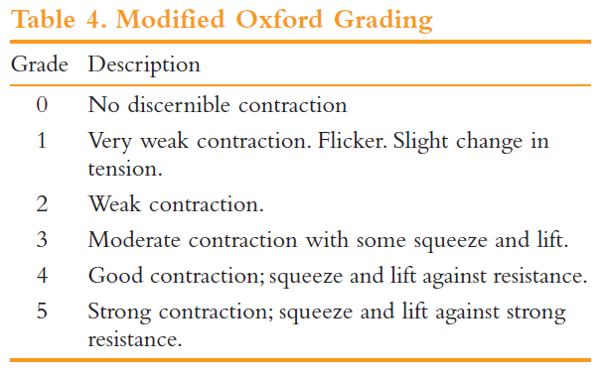

Slide 13
The method of grading most commonly used in the UK was proposed by Laycock & Chiarelli
It is a six-point modelled on the Oxford scale.
P power – which is more correctly the ‘strength’ of the PFM determined
E endurance – i.e. the time in seconds that a maximum voluntary contraction (MVC) can be held before fatigue.
R repetitions – i.e. the number of MVCs which can be performed (up to
10) interspersed with rests of 4 seconds
F fast – i.e. the number of 1-second contractions (up to 10) performed,
ECT – i.e. ‘every contraction timed’ )

Slide 15
Management
Conservative modalities begin with exercises to strengthen the pelvic floor musculature (Kegel exercises).
Mechanical support devices (pessaries) may be used to manage prolapse and the associated symptoms, or
The defect may be repaired surgically.

Slide 16
Integrated Care For Older People (ICOPE) guidelines on community level intervention to manage declines in intrinsic capacity, Evidence Profile - WHO
Prompted voiding for the management of urinary incontinence can be offered for older people with cognitive impairment.
Strength of the recommendation: Conditional
Quality of evidence: Very low
Pelvic floor muscle training (PFMT), alone or combined with bladder control strategies and self-monitoring, should be recommended for older women with urinary incontinence (urge, stress or mixed).
Strength of the recommendation: Strong
Quality of evidence: Moderate

Slide 17
RODRIGO PEDRAZA ET AL 2014
The PMR protocols offers a standardized approach to diagnose and manage pelvic floor dysfunction syndromes with potential advantages over traditional biofeedback involving additional interventions and a continuous pelvic floor assessment with management modification over the clinical course.

Slide 18
References
Pelvic Muscle Rehabilitation: A Standardized Protocol for
Pelvic Floor Dysfunction Rodrigo Pedraza.
Pelvic Floor Re-education Principles and Practice Second Edition
Kaven Baessler, Bernhard Schussler, Kathryn L. Burgio, Kate H.Moore, Peggy A. Norton, and Stuart L. Stanton (Eds.)

Slide 19
THANK YOU

